Slide 1
CS 440 Group 20:
Travel Advisor
Hongcheng Wu, Spancer Guo, Jiajie Lin, Zachary Flebbe

Slide 2
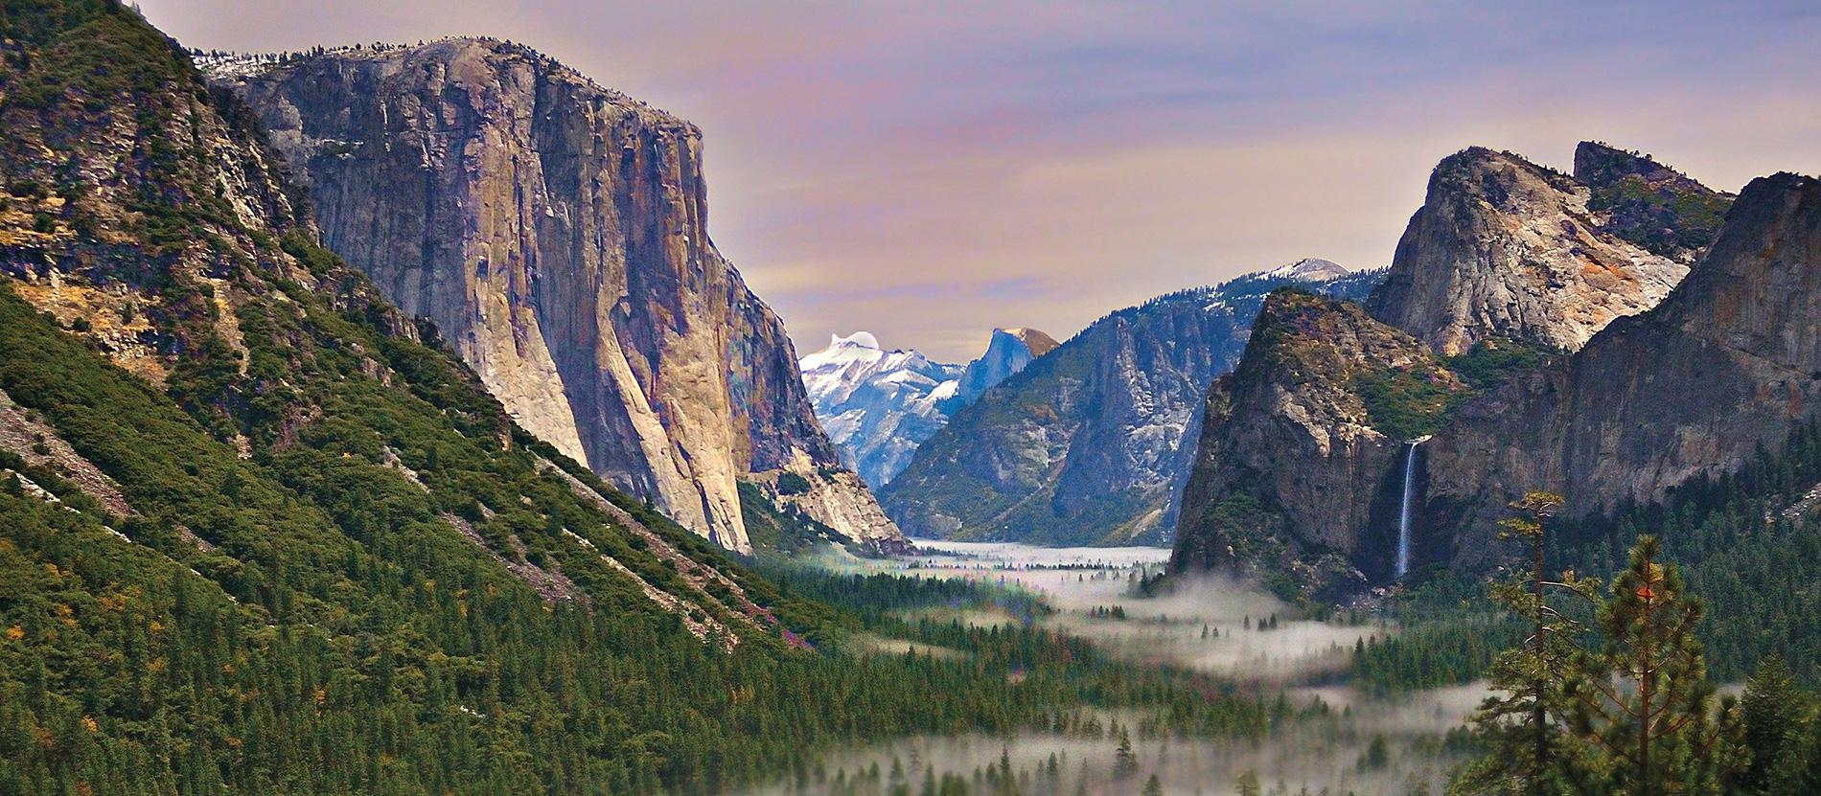
Travel Advisor: Enhancing the National Park experience!

Slide 3
What is Travel Advisor?
Travel Advisor is a mobile application designed to improve the National Park experience.
It contains useful features to help visitors navigate the park and improve park safety.
Ideally, this will increase the number of visitors coming to the National Parks.
Notes:
Zack

Slide 4
Travel Advisor Key Features
Park Information
Schedule
Ratings
History
Weather Advisory
Photo Gallery
User Submitted photos
Ability to comment and share
Navigation System
Scenic spots displayed
Click on map to display route
Emergency Rescue
Notes:
Zack

Slide 5
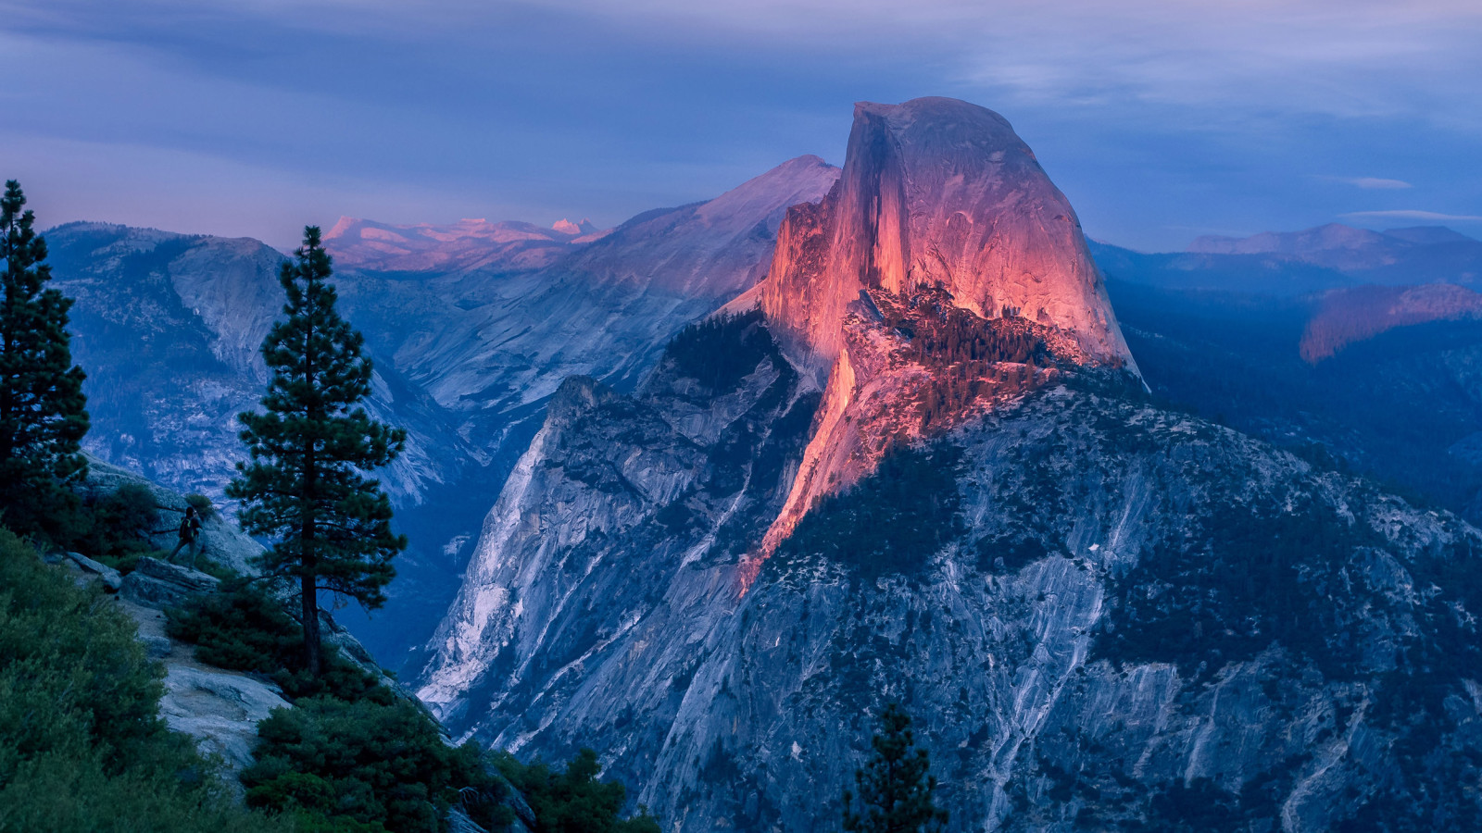
Park Information
The park’s general information such as hours, rating, parking information etc. will be provided here.
This will also contain a brief description of the park along with park history.
Notes:
Spancer

Slide 6

Weather Advisor
The system will display the forecasted weather on the map for different areas of the park. For example: fog on the north side of the park or rain in the south side of the park.
Gathers and analyses weather data; some species are very rare and specific about weather and time, this will help users to observe certain species.
Notes:
Spancer

Slide 7

Photo Gallery
Not just a photo gallery, more like a web community where professionals and amateurs can share photos and stories pertaining to the park
This feature connects visitors that are interested in the park and develops a network between users.
Users can submit their own pictures, and once it approved it will be posted in the photo gallery.
Users have the ability to comment on photos.
Notes:
Spancer

Slide 8
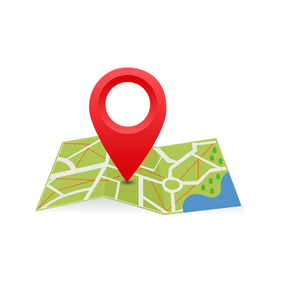
Navigation System
Each location in the park is marked on the map; a brief description of each location will be provided.
Users can use this to navigate through the park.
Displaying scenic spots and species activity spots around route.
Notes:
Spancer

Slide 9

Emergency Rescue
The emergency rescue feature would consist of a very minimal UI with a button.
When the button is pressed, the devices’ current GPS coordinates are recorded and immediately relayed to rescue teams.
There is a high likelihood the device could run out of battery so this must be instantaneous.
Largest National Park: Gates of the Artic: 13,238 square miles; Larger than Belgium.
Notes:
Spancer

Slide 10
Who is Travel Advisor for?
Travel Advisor benefits not only the visitors of the National Parks, but the parks themselves.
By using the application, visitors are able to get the best experience possible.
Optimize time within the park
Share experiences with others via the photo gallery
Ensure visitor safety, in turn, makes people more likely to return & refer others; this benefits the park.
Notes:
Jiajie

Slide 11
Other Stakeholders
Technology experts
provide customers with the best technology
They have to understand the customer’s demands and developer’s needs
Software Developer
In charge of the software architecture.
UI, back-end, and maintenance of the software.
Notes:
Jiajie

Slide 12
Other Stakeholders
(continued)
Legal
ensure all the data is safe for all customers.
Must obey all fundamental ethical rules and regulatory boundaries.
Must protect data and prevent any mishaps with information
Notes:
Jiajie

Slide 13
How is Travel Advisor used?
Travel Advisor requires only a smartphone.
Both practical and portable
Cell phone service is required to access the navigation system, photo gallery and the emergency rescue feature.
Offline users still have access to downloadable trail maps.
Notes:
Hongcheng

Slide 14
The Scope of the Work
Weather advisor is constantly updating weather data; creates precautions for future days, and predicts species activity
Clients can share their experiences, new finds, photos and suggestions on the build-in web community.
If any unexpected emergencies happen, the application provides instructions and 24 hour support.
There are countless travel guide applications existing in the world, why would our clients use this application?
Notes:
Hongcheng

Slide 15
Event List
Analysing weather data; predicts species activity
Navigation system: Plans the way to destinations, showing all scenic spots and species activity spots.
Interactive map: Listing of scenic spots and animals which can be found within the selected area.
Communicate with other user: in photo gallery, user can like and comment on photos.
Notes:
Hongcheng

Slide 16
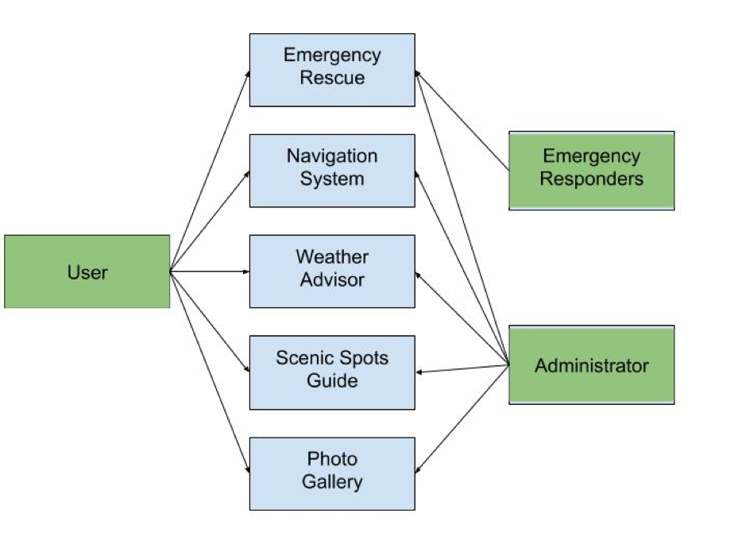
Scenario Diagram
User and Administrator can access all aspects of the system; Emergency Responders can access the rescue feature
Notes:
Zack

Slide 17
Facts and Assumptions
Important facts include the number of people that have used the application; ratings and comments gathered from the users.
This app is only for national parks and the visitors who are traveling in the park use only, and it would require the application installed on a smartphone.
We assume the users of this app have a basic understanding of using a smartphone, and can speak English.
We assume the national parks operate within their current guidelines.
Notes:
Zack

